Slide 1
2025/26 PJM BRA Capacity Market Results
July 2024

Slide 2
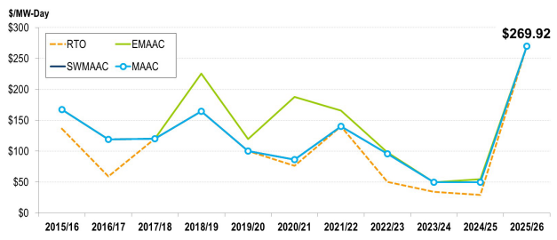
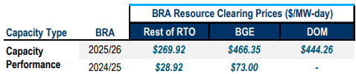
PJM Capacity Auction Prices Clear at All-Time Highs
The results of PJM’s capacity market Base Residual Auction (BRA) for power year June 2025 – May 2026 showed an all-time high in clearing prices of $269.92/MW-day, a 9x increase from its previous auction’s $28.92/MW-day.
Both the Dominion and Baltimore Gas and Electric (BGE) utility zones cleared significantly higher near the auction cap (see right table).
BRA Clearing Prices by Delivery Year by Locational Delivery Area
Both have their own specific supply issues as transmission constraints and insufficient generation in the data center-focused Dominion zone and a couple of Reliability Must-Run contracts handed out in BGE were the likely culprits of such high rates.
Other contributing factors were 3,243 MW increase in forecasted load, a 3.1% jump in reserve margin, and a drop in 6,600 MW of offered resources for this auction.
Customer Takeaway: The surprisingly high clearing rates were likely a combination of both a tightening supply/demand balance in the region as well as FERC-approved changes which modified the quantitative value of each capacity resource depending on fuel type. An efficient market would point to more future investment to capitalize on such high capacity revenues which would help mitigate load growth and resiliency risks.
Sources: PJM, S&P Global
Notes:
PJM’s capacity auction has competitively secured resources to meet the RTO reliability requirement for the 2025/2026 Delivery Year. Auction prices were significantly higher across the RTO due to decreased electricity supply caused primarily by a large number of generator retirements, combined with increased electricity demand and implementation of FERC-approved market reforms.”

Slide 3
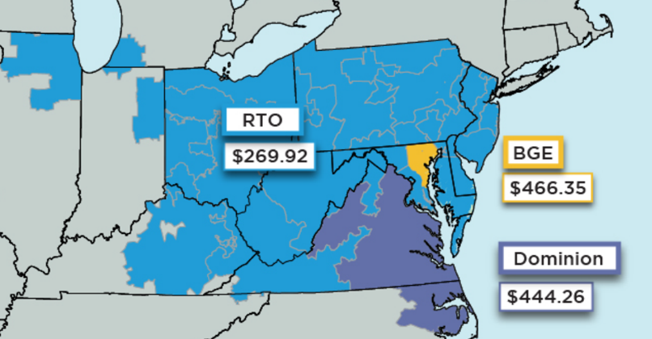
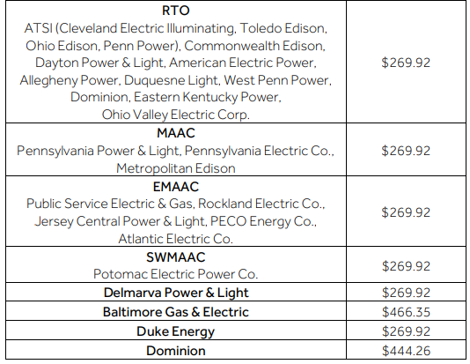
PJM’s 2025/26 Base Residual Auction (BRA) Results
Price surge attributed to the following drivers;
Decreased supply offers into the auction due mainly to generator retirements.
An increase in peak load forecasts.
FERC-approved model changes that aim to better reflect risks from extreme weather, coupled with new resource accreditation metrics for a more accurate picture of what a plant can deliver during high stress times in the region.
Customer Takeaway: An overall tightening of the electricity supply/demand balance in PJM, along with FERC-approved market rules have caused a spike in RTO capacity clearing prices which will significantly increase the price a customer will have to pay for this cost component but at the same time provide investment incentives to new generation providers.
Source: Constellation; PJM,

Slide 4
PJM 2025/26 Capacity Auction Cost Implications
Cost example using 2025/26 BRA results for a customer with a 1 MW capacity tag for this planning year located within the RTO LDA. ***Prices used are based on the Adjusted Preliminary Zonal Net Load Price.
Monthly $270.35/MW-day x 1 MW x 31 days in cycle = $8,381 monthly compared to the monthly charge of the 2024/25 auction of $899 ($28.99/MW-Day)
Annually $270.35/MW-day x 1 MW x 365 days = $98,678 annually compared to an annual charge of the 2024/25 auction of $10,581 ($28.99/MW-Day)
Cost example using 2025/26 BRA results for a customer with a 1 MW capacity tag for this planning year located within the BGE LDA. ***Prices used are based on the Adjusted Preliminary Zonal Net Load Price.
Monthly $306.98/MW-day x 1 MW x 31 days in cycle = $9,516 monthly compared to the monthly charge of the 2024/25 auction of $1,855 ($59.83/MW-Day)
Annually $306.98/MW-day x 1 MW x 365 days = $112,048 annually compared to an annual charge of the 2024/25 auction of $21,838 ($59.83/MW-Day)
Cost example using 2025/26 BRA results for a customer with a 1 MW capacity tag for this planning year located within the DOM LDA. ***Prices used are based on the Adjusted Preliminary Zonal Net Load Price.
Monthly $429.57 /MW-day x 1 MW x 31 days in cycle = $13,317 monthly compared to the monthly charge of the 2024/25 auction of $899 ($28.99/MW-Day)
Annually $429.57 MW-day x 1 MW x 365 days = $156,793 annually compared to an annual charge of the 2024/25 auction of $10,581 ($28.99/MW-Day)
The Zonal Net Load Price are what the load pays as the clearing price results is what is paid to the generation.
Source: Constellation; NRG

Slide 5
Key Details from 2025/26 Auction Results
The auction produced a price of $269.92/MW-day for much of the PJM footprint, compared to $28.92/MW-day for the 2024/2025 auction, producing a total cost to consumers of $14.7B from $2.2B in the last auction.
The auction procured 135,684 MW for the period of 6/1/25 – 5/31/26 with an additional 10,886 MW from the Fixed Resource Requirement (FRR) obligation for a total of 146,570 MW, representing an 18.5% reserve margin, compared to a 20.4% reserve margin for the previous auction; total amount of capacity procured declined by 5,743.6 MW from the previous auction.
Supply offered into the RPM capacity market, excluding EE resources, declined 13,252.1 MW from 148,945.7 MW in the 2024/2025 BRA to 135,692.3 MW in the 2025/2026 BRA. This is the fourth auction in a row where the total capacity offered from non-EE resources has declined.
The peak load forecast has increased from 150,640 MW for the 2024/2025 BRA to 153,883 MW for the 2025/2026 Delivery Year.
The BGE and Dominion zones were the only constrained zones in this auction; new generation along with new transmission upgrades are needed here to address the insufficient resources as well as import limitations.
The cleared capacity included about 110 MW of new generation and 755 MW from uprates to existing or planned generation. The quantity of new generation declined by 330 MW from the previous auction.
Gas-fired generation accounted for 48% of the cleared capacity, followed by nuclear at 21%, coal at 18%, demand response at 5%, hydroelectric at 4%, solar and wind at 1% each, and 2% from other resources.
Source: Constellation; PJM, Utility Dive

Slide 6
Disclaimer
The information contained herein has been obtained from sources which Constellation NewEnergy, Inc. and Constellation NewEnergy-Gas Division, LLC (collectively, “Constellation”) believe to be reliable. Constellation does not represent or warrant as to its accuracy or completeness. All representations and estimates included herein constitute Constellation’s judgment as of the date of this document and may be subject to change without notice. This material has been prepared solely for informational purposes relating to our business as a physical energy provider. We are not providing advice regarding the value or advisability of trading, or soliciting or accepting orders for, swaps, options or futures, or any other activity which would cause us or any of our affiliates to be considered a commodity trading advisor or introducing broker under the Commodity Exchange Act. These materials are not intended as a recommendation of, or advice in connection with, a municipal financial product or an issuance of municipal securities. Constellation is not a municipal advisor (within the meaning of the Securities and Exchange Commission’s rules as to the Registration of Municipal Advisors), is not making any financial recommendations to you and is not providing any financial advice. Constellation is not your agent, advisor or fiduciary. Constellation has not assumed, and does not owe, a fiduciary duty to you (within the meaning of the Securities and Exchange Commission’s rules as to the Registration of Municipal Advisors, or otherwise) with respect to the information and material contained herein. You should discuss information of a financial nature with internal or external advisors and experts that you deem appropriate before taking any action related thereto. Constellation does not make and expressly disclaims, any express or implied guaranty, representation or warranty regarding any opinions or statements set forth herein. Constellation shall not be responsible for any reliance upon any information, opinions, or statements contained herein or for any omission or error of fact. All prices referenced herein are indicative and informational and do not connote the prices at which Constellation may be willing to transact, and the possible performance results of any product discussed herein are not necessarily indicative of future results. This material shall not be reproduced (in whole or in part) to any other person without the prior written approval of Constellation.

